Slide 1
Hadoop – Hive
December 2012

Slide 2
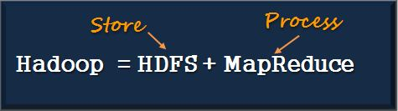
What is Hadoop
Hadoop is a high-performance distributed data storage and processing system. Its two major subsystems are
HDFS for storage
Mapreduce for parallel data processing.
It can store any kind of data from any source, inexpensively and at very large scale, and it can do very sophisticated analysis of that data easily and quickly.
Hadoop automatically detects and recovers from hardware, software and system failures.
Hadoop provides scalable, reliable and fault tolerant services for data storage and analysis at very low cost.

Slide 3

Pattern: Write once, Read many times
Developer | Apache Software Foundation
Stable release | 1.0.4/Oct 12, 2012
Preview release | 2.0.2/Oct 9, 2012
Development Program | Java
Operating System | Cross Platform
Type: | Distributed File system

Slide 4
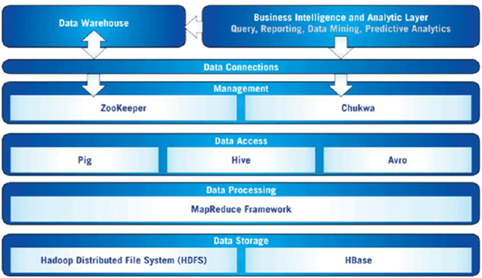
Hadoop Ecosystem, and Analytics

Slide 5
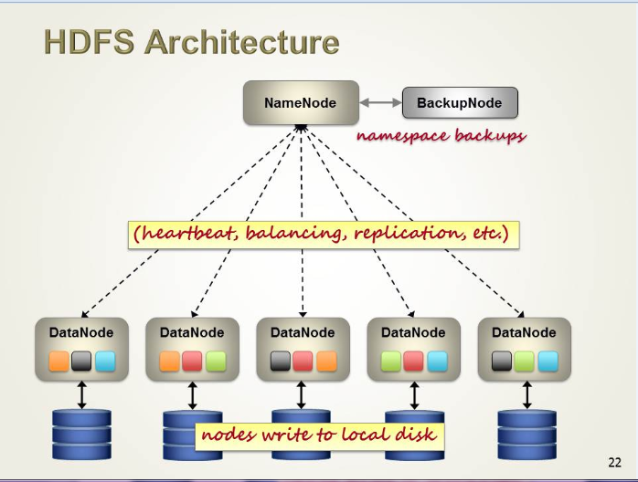
HDFS Architecture

Slide 6
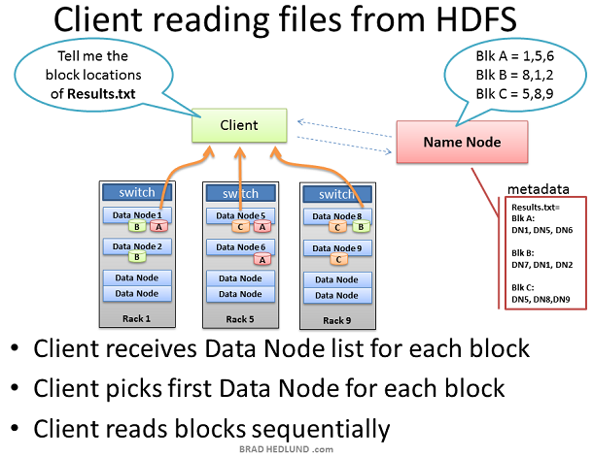
Client reading from HDFS

Slide 7
Introduction to Hive
What is Hive
What is not Hive
Architecture

Slide 8
Introduction
Hive, a framework for data warehousing on top of Hadoop.
Hadoop has Storage (HDFS) and Processing(MAP REDUCE).
Hive grew from a need to manage and learn from the huge volumes of data.
REAL TIME EXAMPLE –FACEBOOK.
Hive was created to make it possible for analysts with strong SQL skills to run queries on the huge volumes of data that Facebook Stored in HDFS.

Slide 9
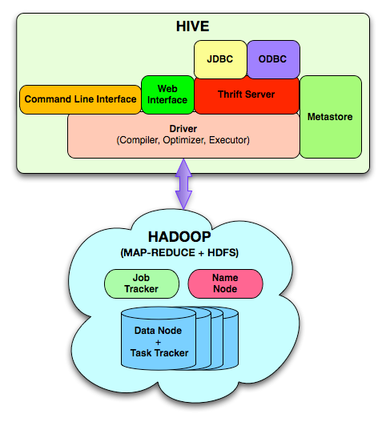
Hive Architecture

Slide 10
Data Model
Hive structures data into well-understood database concepts such as: tables, rows, cols, partitions
It supports primitive types: integers, floats, doubles, and strings
Hive also supports:
associative arrays: map<key-type, value-type>
Lists: list<element type>
Structs: struct<file name: file type…>
SerDe: serialize and deserialized API is used to move data in and out of tables

Slide 11
Query Language (HiveQL) Subset of SQL Limited equality and join predicates No inserts on existing tables Can overwrite an entire table
 | Hive Query Language (HQL)
Application | Create Data Structures | Loading Data into Tables | Queries on table data
Example Functions | CREATE/DROP table, ALTER table, CREATE/DROP view, CREATE/DROP function, SHOW/DESCRIBE | LOAD DATA INTO table INSERT OVERWRITE TABLE | SELECT ..WHERE.. GROUP BY SORT BY ORDER BY JOIN UNION EXPLAIN

Slide 12
Situation | Description
LOAD DATA INTO ... | Storage Location of Data
SORT BY and ORDER BY | SORT BY sorts per reducer whereas ORDER BY enforces total order across the entire dataset
DISTRIBUTE BY and CLUSTER BY | Hive uses the columns in DISTRIBUTE BY to distribute the rows among reducers. CLUSTER BY is a short cut for both DISTRIBUTE BY and SORT BY.
Hive does not have the SQL statements: INSERT UPDATE DELETE | Hive (and Hadoop) technologies are designed for Data Warehousing type applications (or write once, read many times). This is the underlying reason why these fundamental SQL statements are not available in Hive. Most of the functionality of SQL statements INSERT, UPDATE and DELETE can be replicated through the use of the INSERT OVERWRITE TABLE.

Slide 13
Hive does not support PRIMARY KEY FOREIGN KEY CREATE INDEX | The nature of Hadoop (and Hive which executes on Hadoop) does not support indexes in tables. for this reason there are no functions to support creating indexes an keys.
JOIN syntax | Inner, outer and left semi-joins are supported in Hive Multiple tables can be joined in a single query Hive converts the multiple JOINS into a single MapReduce job.
DATE functions | There is NO date data type in Hive.

Slide 14
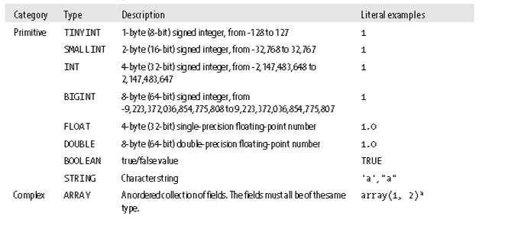
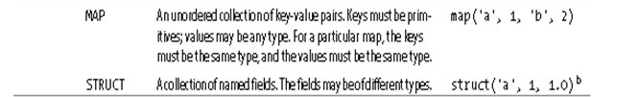

Slide 15
Tables
A Hive table is logically made up of the data being stored and the associated metadata describing the layout of the data in the table.
The data typically resides in HDFS, it may reside in any Hadoop filesystem, including the local filesystem or S3.
Ex: CREATE TABLE page_view(viewTime INT, userid BIGINT, page_url STRING, referrer_url STRING, ip STRING COMMENT 'IP Address of the User') COMMENT 'This is the page view table' PARTITIONED BY(dt STRING, country STRING) ROW FORMAT DELIMITED FIELDS TERMINATED BY ‘,' STORED AS SEQUENCEFILE;
There are two types of tables:
Managed Tables
External Tables

Slide 16
Managed Tables & External Tables
The difference between the two types of table is seen in the LOAD and DROP semantics.
When you load data into a managed table, it is moved into Hive’s warehouse directory.
For example:
CREATE TABLE managed_table (dummy STRING);
LOAD DATA INPATH '/user/tom/data.txt' INTO table managed_table;
If the table is later dropped, using:
DROP TABLE managed_table;
Then the table, including its metadata and its data, is deleted

Slide 17
Managed Tables & External Tables
An external table behaves differently. You control the creation and deletion
of the data.
The location of the external data is specified at table creation time.
CREATE EXTERNAL TABLE external_table (dummy STRING)
LOCATION '/user/tom/external_table';
LOAD DATA INPATH '/user/tom/data.txt' INTO TABLE external_table;
This is a useful feature, since it means you can create the data lazily after creating the table.
When you drop an external table, Hive will leave the data untouched and only delete the metadata.

Slide 18
Partitions and Buckets
Hive organizes tables into partitions, a way of dividing a table into coarse-grained parts based on the value of a partition column, such as date.
Partitions can make it faster to do queries on slices of the data.
Tables or partitions may further be subdivided into buckets, to give extra structure to the data that may be used for more efficient queries.

Slide 19
Partitions and Buckets
Partitions are defined at table creation time using the PARTITIONED BY clause, which
takes a list of column definitions.
Ex:
CREATE TABLE logs (ts BIGINT, line STRING)
PARTITIONED BY (dt STRING, country STRING);
When we load data into a partitioned table, the partition values are specified explicitly:
LOAD DATA LOCAL INPATH 'input/hive/partitions/file1'
INTO TABLE logs
PARTITION (dt='2001-01-01', country='GB’);
At the filesystem level, partitions are simply nested subdirectories of the table directory.
After loading a few more files into the logs table, the directory structure might look
like this:
/user/hive/warehouse/logs/dt=2010-01-01/country=GB/file1
/file2
/country=US/file3
/dt=2010-01-02/country=GB/file4
/country=US/file5
/file6

Slide 20
Storage Formats
There are two dimensions that govern table storage in Hive
1. row format
2. file format.
The row format dictates how rows, and the fields in a particular row, are stored
The file format dictates the container format for fields in a row.
The simplest format is a plain text file, but there are row-oriented and column-oriented binary formats.
The default storage format: Delimited text:
When you create a table with no ROW FORMAT or STORED AS clauses, the default format is delimited text, with a row per line.

Slide 21
User Defined Functions(UDF)
The query you want to write can’t be expressed easily (or at all) using the built-in functions that Hive provides.
By writing a user-defined function (UDF), Hive makes it easy to plug in your own processing code and invoke it from a Hive query.
UDFs have to be written in Java, the language that Hive itself is written in.
There are three types of UDF in Hive:
(regular) UDFs
UDAFs (user-defined aggregate functions)
UDTFs (user-defined table-generating functions).

Slide 22
Language capabilities
Hive Query Language provides the basic SQL like operations. These operations work on tables or partitions. These operations are:
Ability to filter rows from a table using a where clause.
Ability to select certain columns from the table using a select clause.
Ability to do equi-joins between two tables.
Ability to evaluate aggregations on multiple "group by" columns for the data stored in a table.
Ability to store the results of a query into another table.
Ability to download the contents of a table to a local (e.g., nfs) directory.
Ability to store the results of a query in a hadoop dfs directory.
Ability to manage tables and partitions (create, drop and alter).
Ability to plug in custom scripts in the language of choice for custom map/reduce jobs.

Slide 23
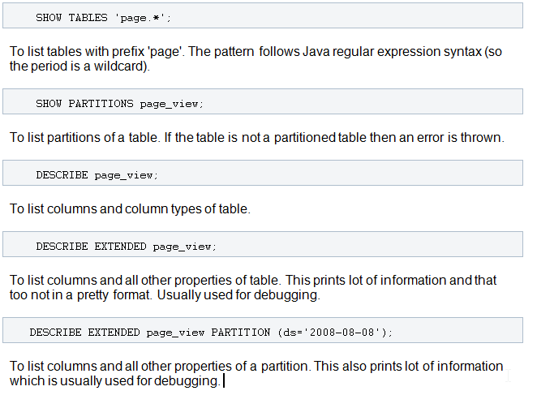
Browsing Tables and Partitions

Slide 24
Thanks

